Slide 1

SMART on FHIR
Slides at bit.ly/smart-fhir-2016
@JoshCMandel @SMARTHealthIT
@JoshCMandel @SMARTHealthIT
Harvard Medical School

Slide 2

SMART's Core Focus
Slides at bit.ly/smart-fhir-2016
@JoshCMandel @SMARTHealthIT
}
{
Clinicians
Researchers
Consumers
(et al.)

Slide 3
SMART's Core Focus
Slides at bit.ly/smart-fhir-2016
@JoshCMandel @SMARTHealthIT
}
{
Clinicians
Researchers
Consumers
(et al.)
Healthcare
IT Systems
>1200 Certified EHRs
& Portals
& Data warehouses

Slide 4
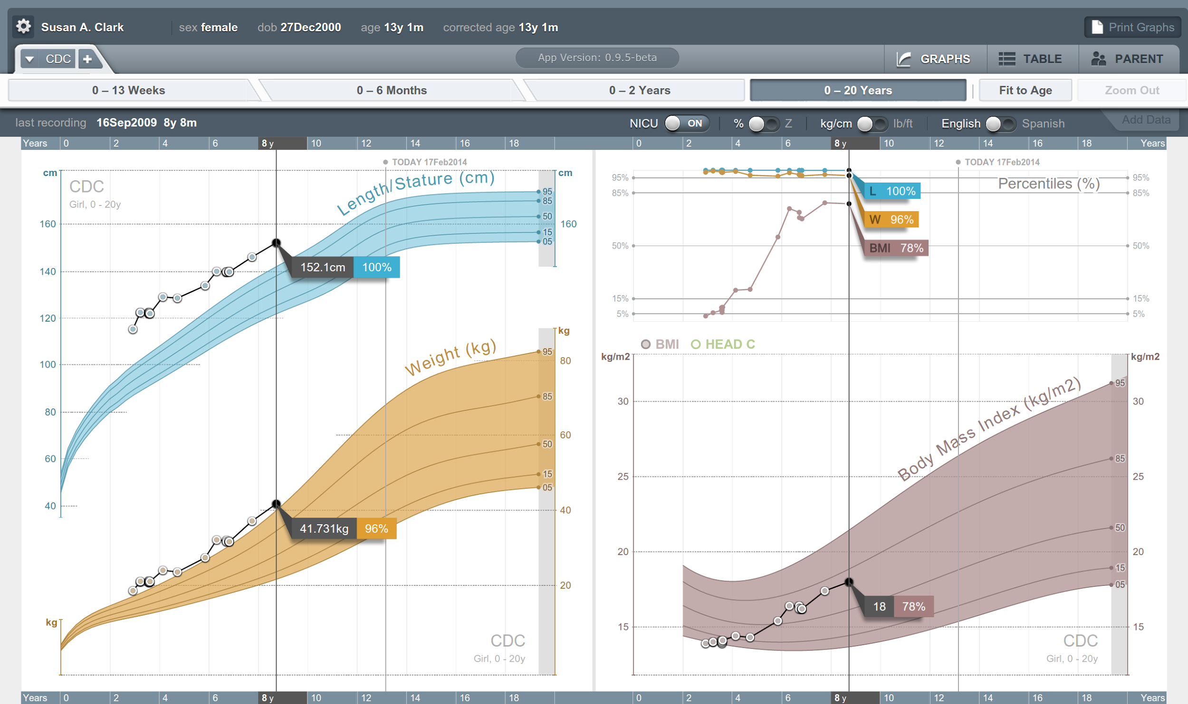
SMART's Core Focus
Slides at bit.ly/smart-fhir-2016
@JoshCMandel @SMARTHealthIT
}
{
Healthcare
IT Systems

Slide 5
SMART's Core Focus
Slides at bit.ly/smart-fhir-2016
@JoshCMandel @SMARTHealthIT
}
{
clinical data
authorization
authentication
UX
Healthcare
IT Systems

Slide 6
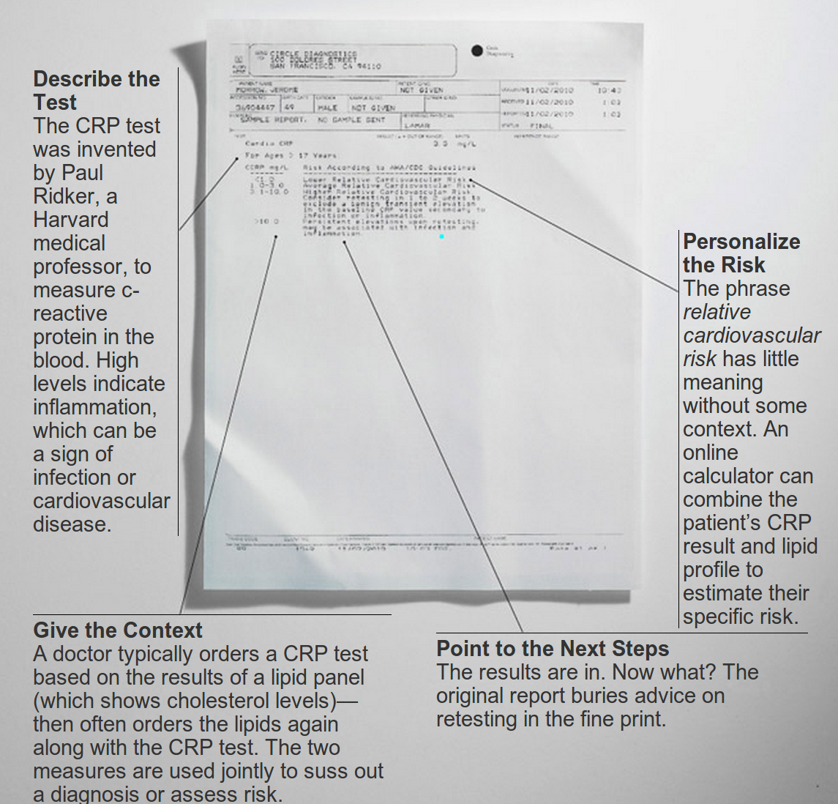
Motivation: Let people with ideas...
Slides at bit.ly/smart-fhir-2016
@JoshCMandel @SMARTHealthIT

Slide 7
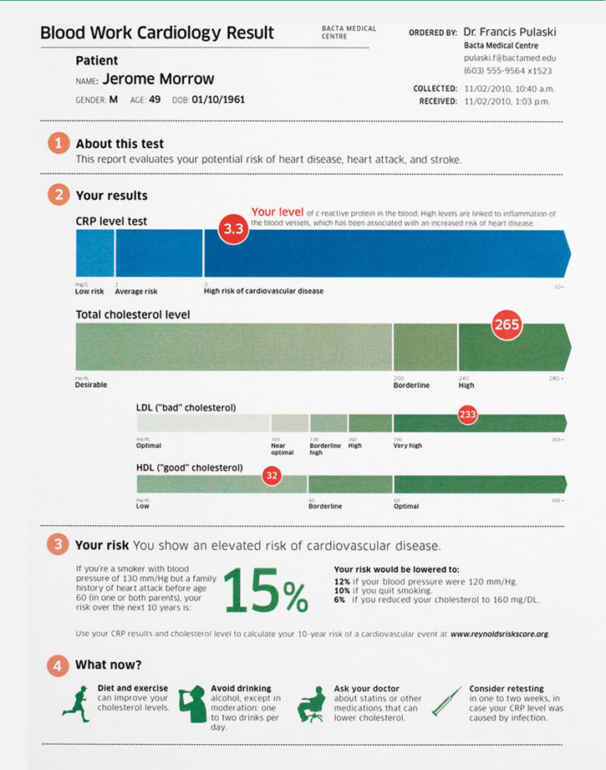
… do better than publishing PDFs!
Slides at bit.ly/smart-fhir-2016
@JoshCMandel @SMARTHealthIT
Notes:
http://www.wired.com/2010/11/ff_bloodwork/all/

Slide 8

Slides at bit.ly/smart-fhir-2016
@JoshCMandel @SMARTHealthIT
Substitutability = choice
BP Centiles
Med Manager
Cardiac Risk
Apps
SMART-Enabled
EMR

Slide 9
Slides at bit.ly/smart-fhir-2016
@JoshCMandel @SMARTHealthIT
Substitutability = re-use
Cardiac Risk
SMART-Enabled
PCHR
SMART-Enabled
EMR
SMART-Enabled
HIE

Slide 10
Slides at bit.ly/smart-fhir-2016
@JoshCMandel @SMARTHealthIT
Why would EHRs do this?
One code base, thousands of customers – hard to customize
Customers have unique needs, need fast response, want to experiment
Lesson from cell phones – no apps = no sales

Slide 11
Slides at bit.ly/smart-fhir-2016
@JoshCMandel @SMARTHealthIT
SMART's assessment from 2010-2013
Health IT Standards Today …
Focused on document exchange
Not open or free
Not adequately expressive
Not unambiguous
Not easy to learn
Summation: Not developer-friendly

Slide 12

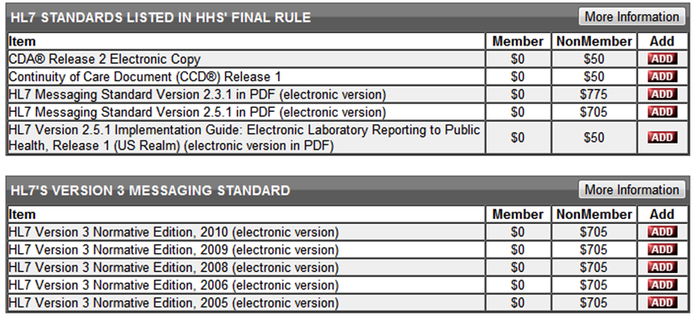
Slides at bit.ly/smart-fhir-2016
@JoshCMandel @SMARTHealthIT
SMART's assessment from 2010-2013
Not free …

Slide 13
Slides at bit.ly/smart-fhir-2016
@JoshCMandel @SMARTHealthIT
SMART's assessment from 2010-2013
Not easy to learn…
<observation classCode="OBS" moodCode="EVN">
<templateId root="2.16.840.1.113883.3.88.11.83.15“ … />
<templateId root="2.16.840.1.113883.10.20.1.31" … />
<templateId root="1.3.6.1.4.1.19376.1.5.3.1.4.13" … />
<id root="107c2dc0-67a5-11db-bd13-0800200c9a66" />
<code code="30313-1" codeSystem="2.16.840.1.113883.6.1" displayName="HGB" />
<statusCode code="completed" />
<effectiveTime value="200003231430" />
<value xsi:type="PQ" value="13.2" unit="g/dl" />
<interpretationCode code="N" codeSystem="2.16.840.1.113883.5.83" />
<referenceRange>
<observationRange>
<text>M 13-18 g/dl; F 12-16 g/dl</text>
</observationRange>
</referenceRange>
</observation>
<text>M 13-18 g/dl; F 12-16 g/dl</text>

Slide 14
First Take: SMART "Classic"
Slides at bit.ly/smart-fhir-2016
@JoshCMandel @SMARTHealthIT
RDF Data models (now deprecated)
Relations everywhere (data == graph)
Natural use of vocabularies (terms == URIs)
Readily extensible (just add triples)
Docs example: demographics

Slide 15
First Take: SMART "Classic"
Slides at bit.ly/smart-fhir-2016
@JoshCMandel @SMARTHealthIT
"Apparently the layout of the Demographic RDF in the developer’s documentation is a logical representation and not a physical one."
"Had the payload been a typical XML document where the data relationships are expressed in its structure, the cognitive overhead would have been non existent."

Slide 16
First Take: SMART "Classic"
Slides at bit.ly/smart-fhir-2016
@JoshCMandel @SMARTHealthIT
Attempted solutions to "developer experience" woes
Education (tutorials, sample code, discussion group)
Libraries (JS, Java, Python, …)
JSON-LD (including "frames" to shape data)

Slide 17
Take Two: SMART on FHIR
Slides at bit.ly/smart-fhir-2016
@JoshCMandel @SMARTHealthIT
FHIR is a draft standard from HL7
Open CC0 License
Clinical models Resources in "plain" JSON/XML
REST API Expressive queries
Community Connectathons, Skype, e-mail list

Slide 18
Building an app platform with FHIR
Slides at bit.ly/smart-fhir-2016
@JoshCMandel @SMARTHealthIT
FHIR is a tool, not an out-of-the-box solution
SMART got involved in 2013
clinical data FHIR + profiles
authorization OAuth 2.0
authentication OpenID Connect
UX Open-source "glue"

Slide 19





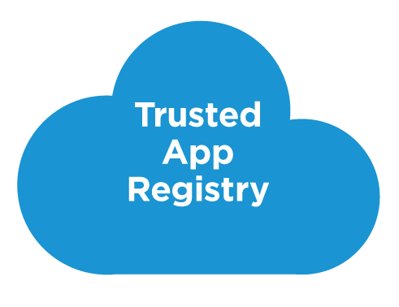



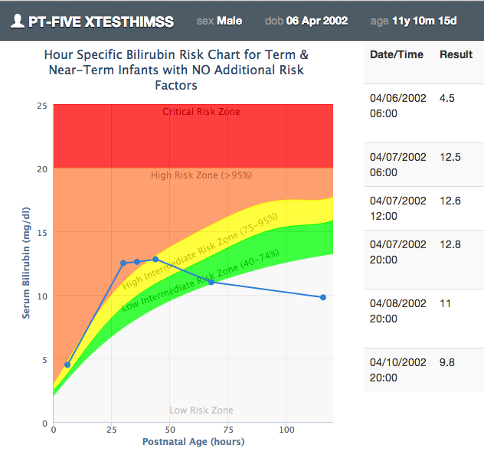

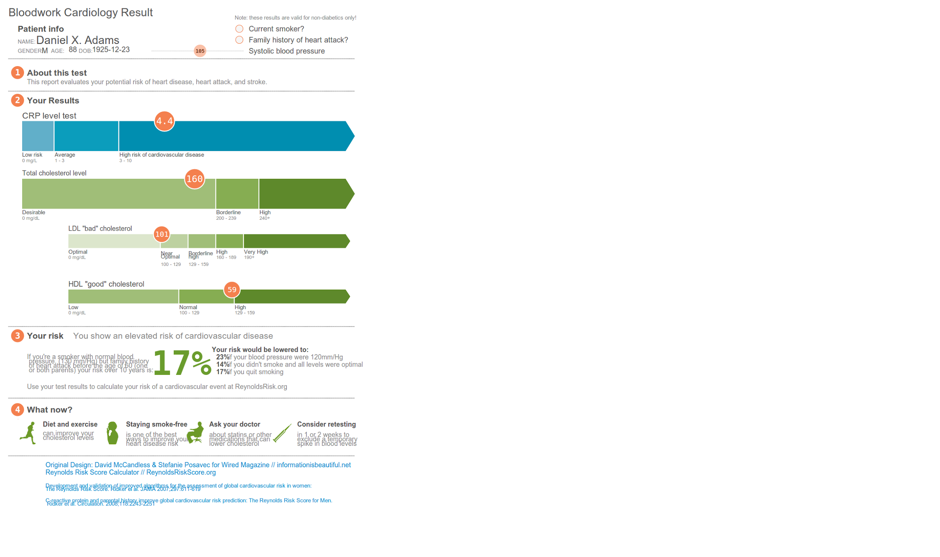



SMART on FHIR®© – Open Platform Architecture
+launch
Mobile Apps
Web Apps
+launch +embed
OAuth2
+authz
+authn
REST API
MU-oriented FHIR Data Profiles
+data
Underlying Health IT Systems
Your system here.

Slide 20

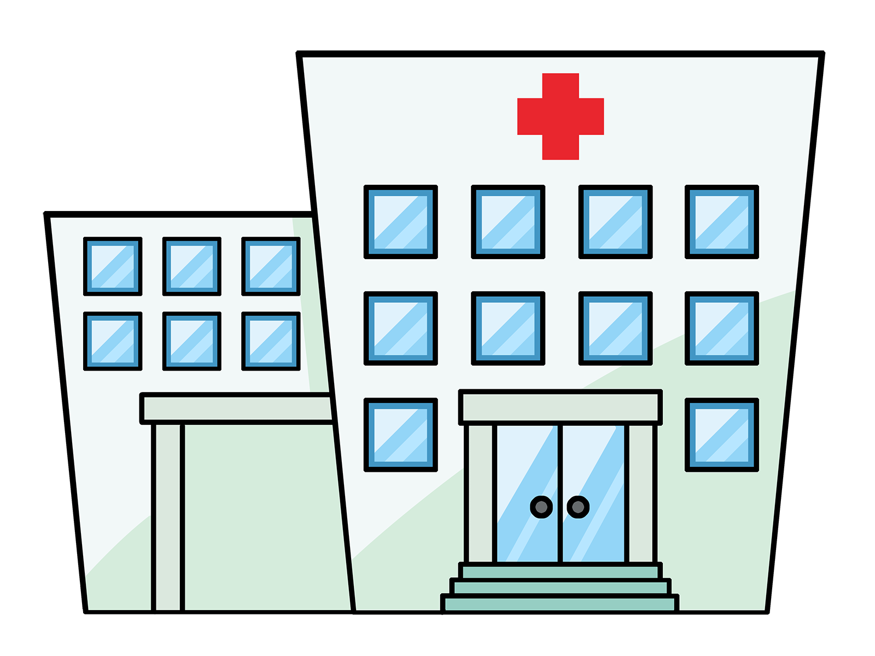


OAuth 2 shines at "access delegation"
User*
Authorize
Data Holder
EHR, Hospital,
Clinic, HIE,
Lab, Insurer, etc.
App
Decision support, visualization, eRx, pop health, etc.
GET /ehr/data
(etc.)

Slide 21
OAuth 2 + OpenID Connect
OAuth 2 + OpenID Connect
User has control over what data app has access to
Authorization and user authentication are separated
Applications can be passed context
Patient, Encounter, Location

Slide 22
Quick demo of SMART
Slides at bit.ly/smart-fhir-2016
@JoshCMandel @SMARTHealthIT
SMART FHIR Starter
SMART App Gallery
Notes:
Check out Scorecard and Samples repository

Slide 23
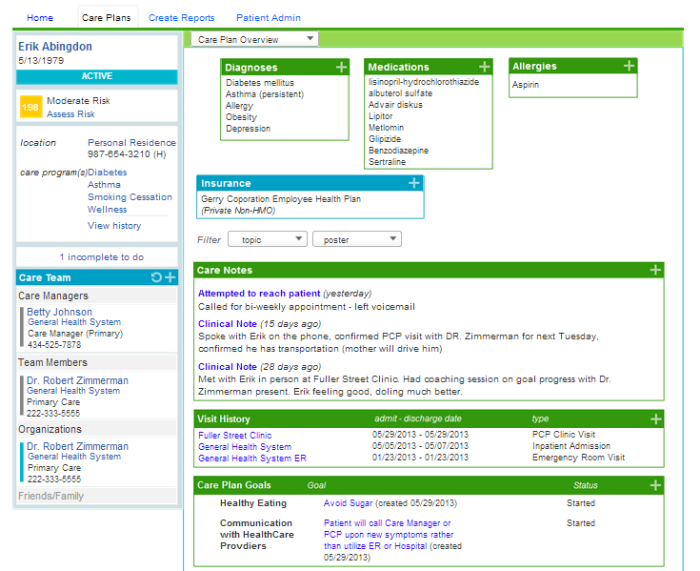
Crimson Care Management
Crimson Care Management
Scalable, Patient-Centered Coordination Across Care Settings
Crimson Care Management App
Risk score updated as diagnoses pulled in from the EMR using FHIR
Patient clinical information (including diagnoses, medications and allergies) automatically fed into EMR using FHIR
Gaps in care presented to caregiver to view, act on, and update on completion
Under Development: Care notes captured during care management encounter sent back to EMR via FHIR
©2015 The Advisory Board Company • advisory.com
Notes:
x

Slide 24
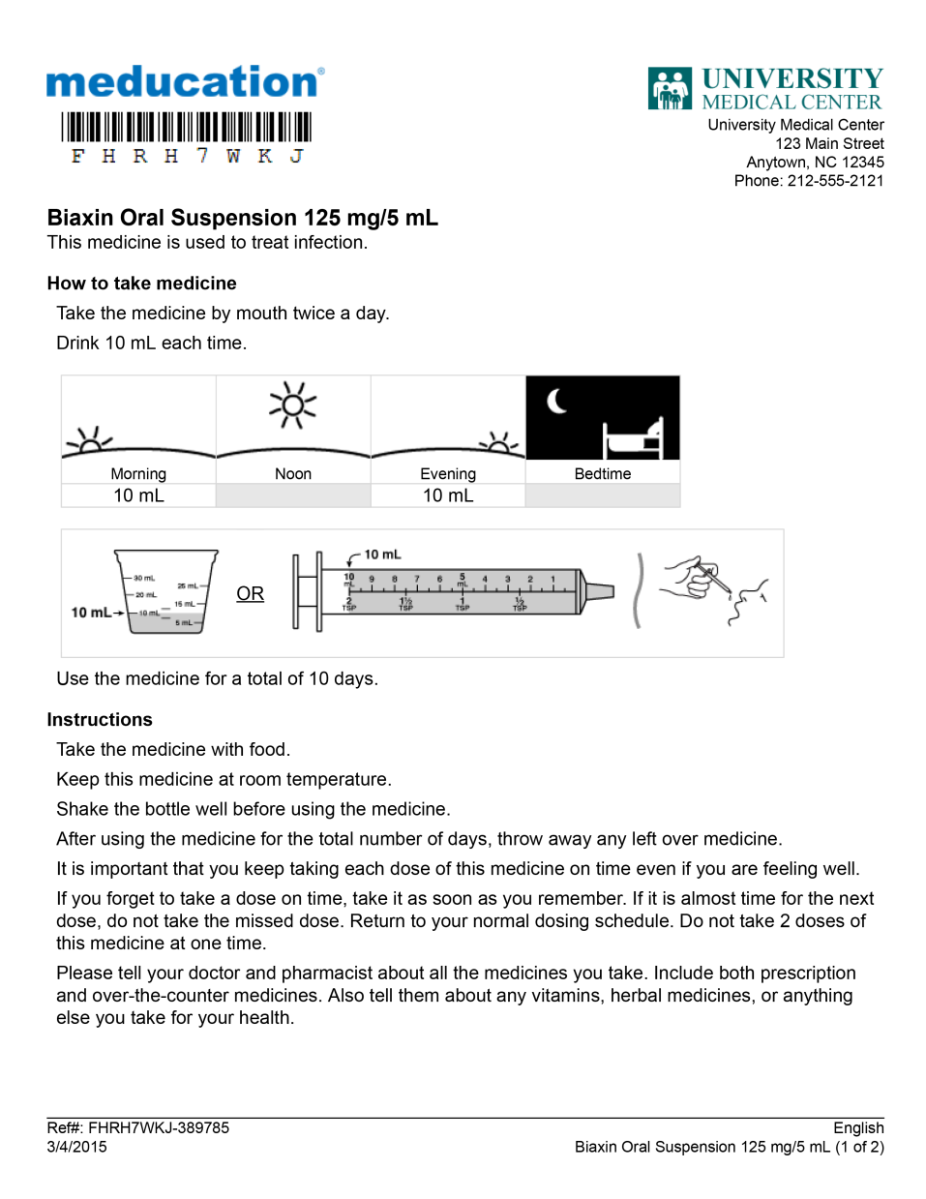

Meducation® Addresses Health Literacy
More Effective Communication
Universal Medication Schedule
Intuitive representations of times of day and amount of medicine to be taken
Pictograms
Reduce dosing errors
Instructions in Plain Speak
1 line per instruction
5th to 8th grade reading level
Visual spacing to reduce cognitive overload
5 font choices, up to 18 point font
Select from more than 20 languages
Notes:
Everything from Polyglot is about improving medication adherence. The solutions that I’ve shown so far have been about improving medication adherence, by addressing low health literacy, by making medication and medical instructions engaging and easy to understand.
TimeView is slightly different in that it is not for patients. It’s for you. Using Surescripts prescription fill or other data sources, TimeView provides a longitudinal view a patient’s adherence history, across all prescribers, displayed in an intuitive, “gantt chart” format, permitting interventions to be tailored quickly and appropriately. The Meducation® TimeView™ Report shows
Visual representation of all medications that a patient has filled over the last 6 months,
Identification of gaps in adherence, as well as “overfill” indicators,

Slide 25
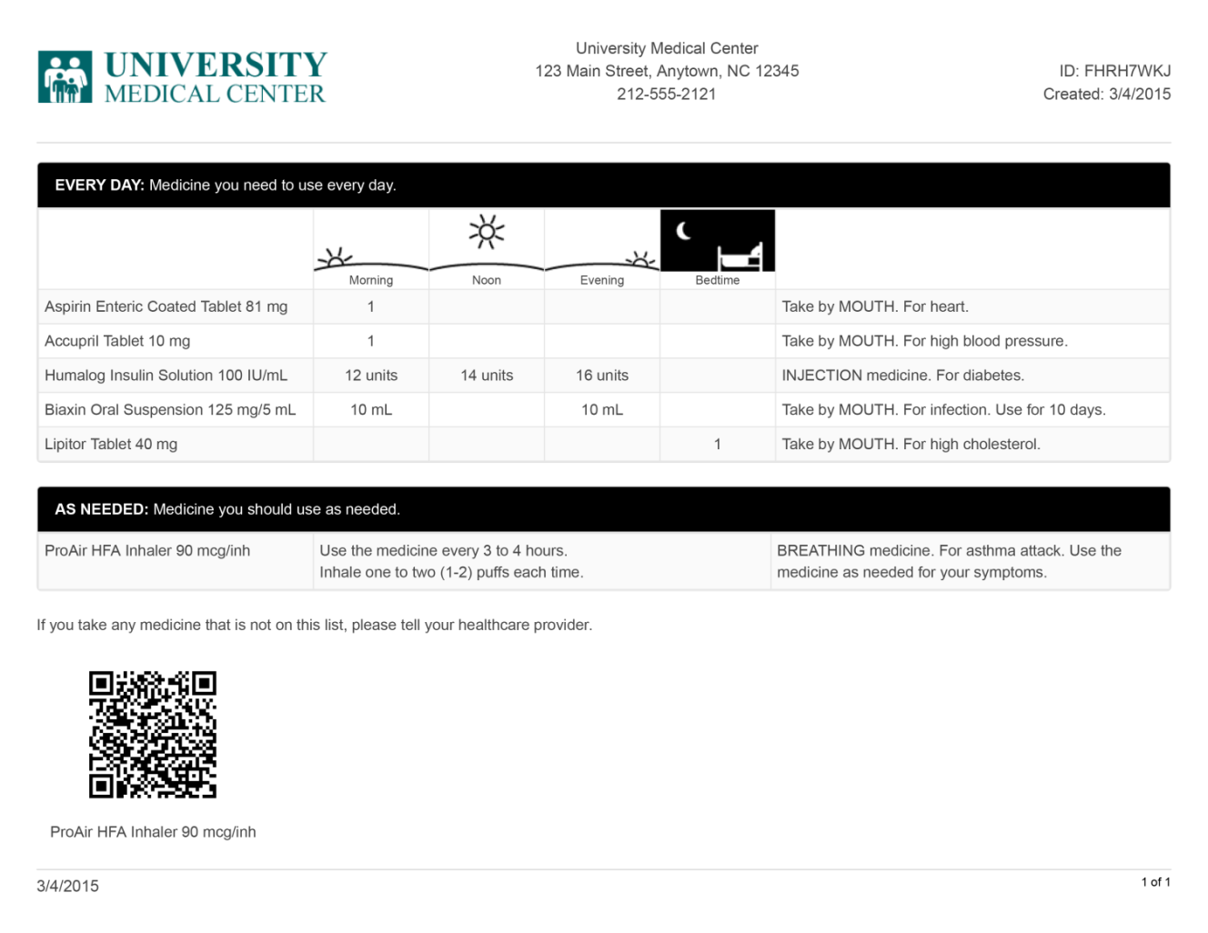
Meducation® Improves Medication Adherence
Multilingual Regimen Summaries
Patient content access via QR code
Notes:
Everything from Polyglot is about improving medication adherence. The solutions that I’ve shown so far have been about improving medication adherence, by addressing low health literacy, by making medication and medical instructions engaging and easy to understand.
TimeView is slightly different in that it is not for patients. It’s for you. Using Surescripts prescription fill or other data sources, TimeView provides a longitudinal view a patient’s adherence history, across all prescribers, displayed in an intuitive, “gantt chart” format, permitting interventions to be tailored quickly and appropriately. The Meducation® TimeView™ Report shows
Visual representation of all medications that a patient has filled over the last 6 months,
Identification of gaps in adherence, as well as “overfill” indicators,

Slide 26
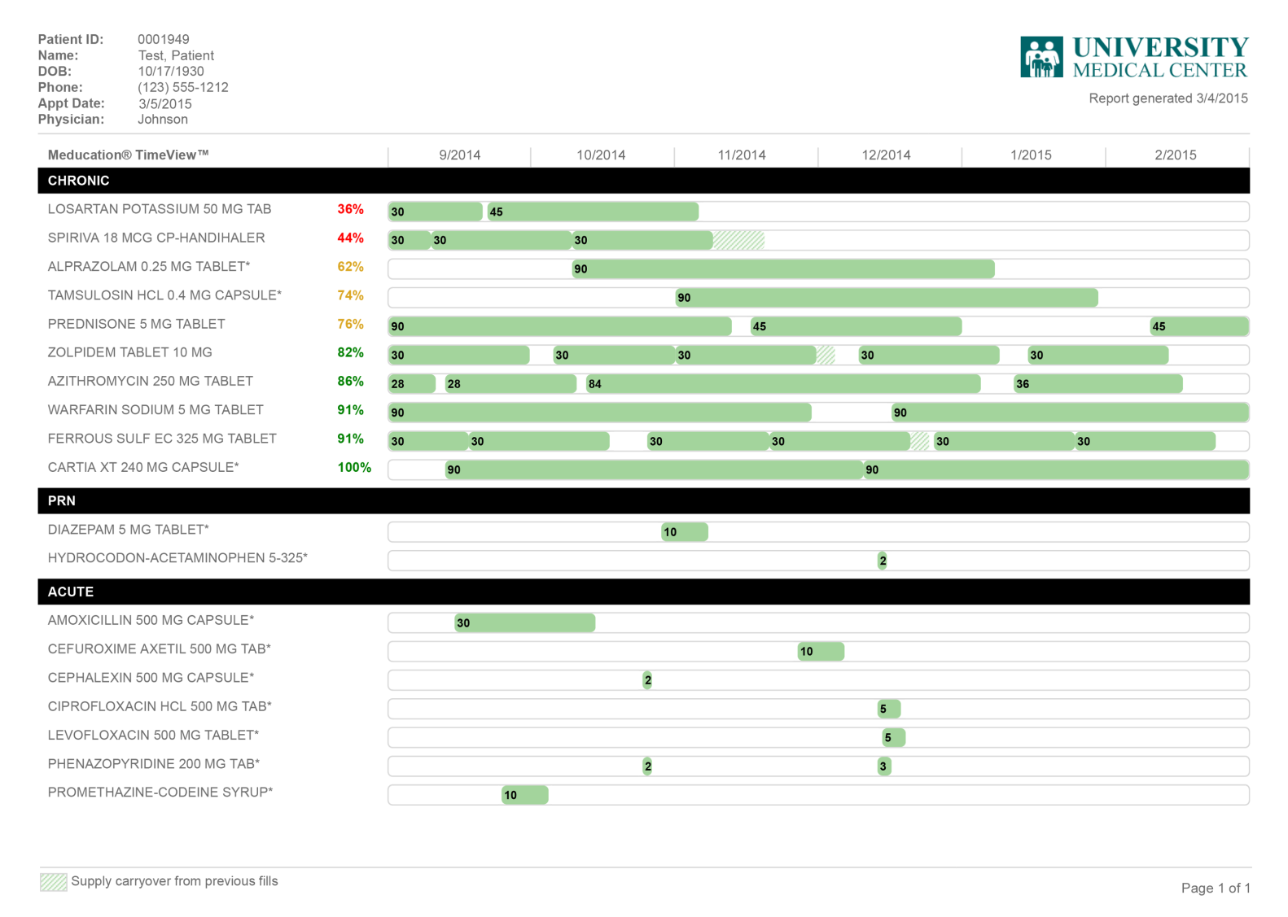
Adherence Intelligence for Clinicians
TimeView™ Adherence Report
Non-adherence indicators
Notes:
Everything from Polyglot is about improving medication adherence. The solutions that I’ve shown so far have been about improving medication adherence, by addressing low health literacy, by making medication and medical instructions engaging and easy to understand.
TimeView is slightly different in that it is not for patients. It’s for you. Using Surescripts prescription fill or other data sources, TimeView provides a longitudinal view a patient’s adherence history, across all prescribers, displayed in an intuitive, “gantt chart” format, permitting interventions to be tailored quickly and appropriately. The Meducation® TimeView™ Report shows
Visual representation of all medications that a patient has filled over the last 6 months,
Identification of gaps in adherence, as well as “overfill” indicators,

Slide 27
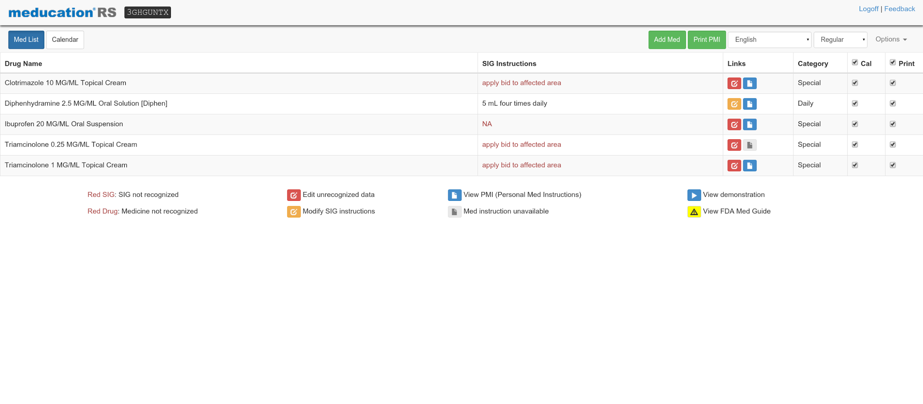

Slide 28
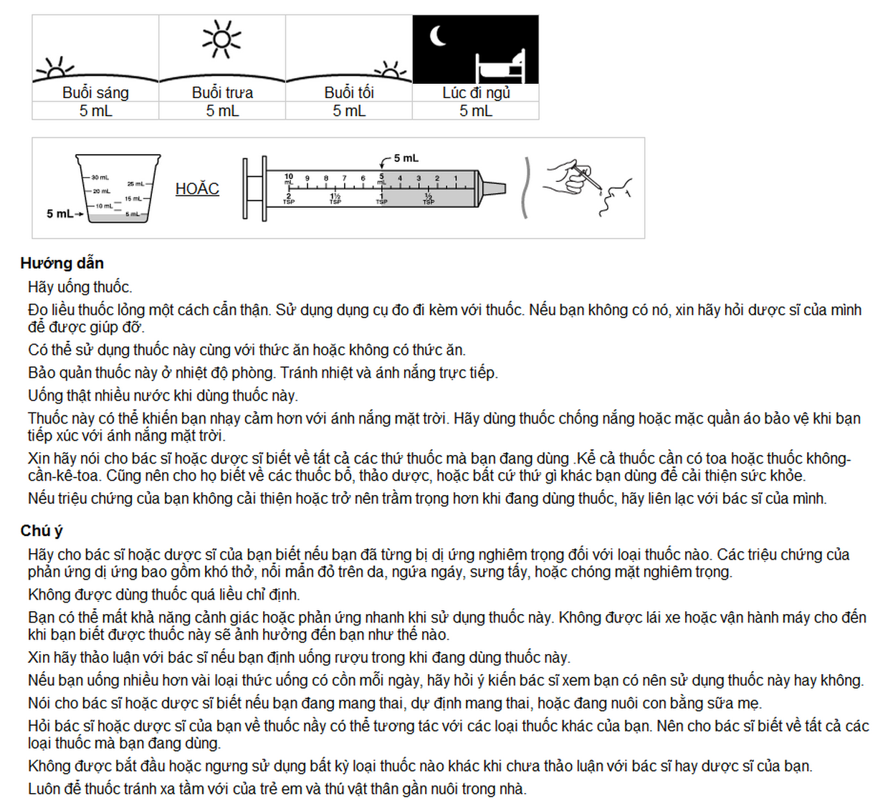

Slide 29
SMART Lessons
Slides at bit.ly/smart-fhir-2016
@JoshCMandel @SMARTHealthIT
We can live without most features (e.g. inter-app communication, complex ordering)
Developer experience > theoretical elegance
Community is key!

Slide 30
SMART on FHIR: Community
Slides at bit.ly/smart-fhir-2016
@JoshCMandel @SMARTHealthIT
+ standards development (HL7)
+ vendors (Argonaut)
+ care providers (HCA, HSPC, Intermountain)
+ data networks (SureScripts)
+ content & app dev (Polyglot, British Medical Journal)
+ pharma (Eli Lilly)
Growing list of partners:
http://smartplatforms.org/advisory-committee/

Slide 31
Discussion
Slides at bit.ly/smart-fhir-2016
@JoshCMandel @SMARTHealthIT
Questions
&

